Slide 1

Becoming a Numeracy Champion
Session 1

Slide 2
Housekeeping
Keep microphones on mute unless speaking
Change your name to be first name + surname using the three dots next to your name
The session is being recorded
Where possible, please have your camera on
In breakout rooms, nominate one person to feed back to the main room
Raise hand to ask or answer questions

Slide 3
National Numeracy
Independent charity established in 2012​
​
Our vision is for everyone in the UK to get on with numbers so they can get on with life. We aim to enable everyone across the UK to be confident and competent in using numbers and data, to be able to make good decisions in their daily life and work.​
​
We are working towards our aim in two main ways:​
Raising awareness about poor numeracy levels which exist in the UK, how numeracy differs from mathematics and promoting the recognition that everyone can improve.​
Improving numeracy. Over 350,000 people have registered to check and improve their maths skills with the National Numeracy Challenge, giving them space to assess and improve on their numeracy at their own pace.​

Slide 4
Programme Objective
To give you the knowledge and skills to support colleagues to improve their skills and confidence with numbers.

Slide 5
Session 1 Objectives
Understand the extent of the numeracy issue in the UK and the reasons for it​
Describe how poor numeracy affects individuals and workplace​s
Describe what maths anxiety is and how it affects individuals​
Understand a positive attitudinal approach to maths learning for low confidence adults​
Understand the value of numeracy in everyday lives​
Understand myths that prevail around maths and feel more confident to encourage learners to think differently about them

Slide 6

How do you feel about maths?

Slide 7
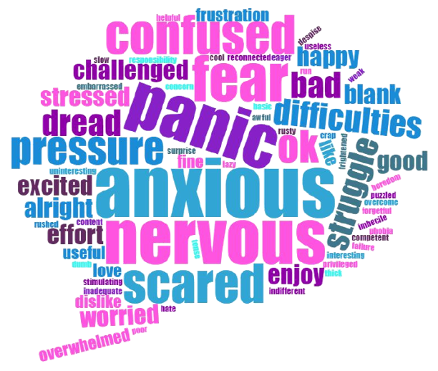
How do you feel about maths?

Slide 8


Numeracy issue in the UK
49%
of adults have the numeracy skills expected of children at primary school
78%
of adults are working below Level 2 (‘C/4’ at GCSE)

Slide 9
Numeracy issue in the UK
Adults with skills equivalent to ‘C/4’ or above at GCSE in England:
57%
44%
26%
22%
Source: Department for Business Innovation and Skills. 2012. ”The 2011 Skills for Life Survey:
A Survey of Literacy, Numeracy and ICT Levels in England.”

Slide 10
Numeracy issue in the UK
Not confident at work
People without
the skills and confidence they need in maths
Hiding stress and anxieties
Pipeline is blocked preventing
staff moving to Functional Skills
Only a very small proportion of those who need help are currently ‘reached’ by Numeracy qualifications
(138,170 in 2020/21).
Staff upskilling through Functional Skills

Slide 11



Numeracy issue in the UK
Functional Skills
Further Progression Routes
1. Address maths anxiety
2. Understand Value, Belief and Persistence
3. Gain the Essentials of Numeracy
Pathway to progression unlocked by improved confidence and overcoming maths anxiety
78% below L2
Low confidence
Maths anxiety
Only currently accessed by a small proportion of the workforce

Slide 12




Economical Cost
Costing billions to the UK each year
£20.2b
1.3%
of GDP
£8.2b
Government
Figure excludes
health and criminal
justice costs
£8.8b
Individuals
Individuals earn less when
they are less numerate
£3.2b
Employers
68% of UK employers are concerned about employees’
ability to sense-check numbers

Slide 13
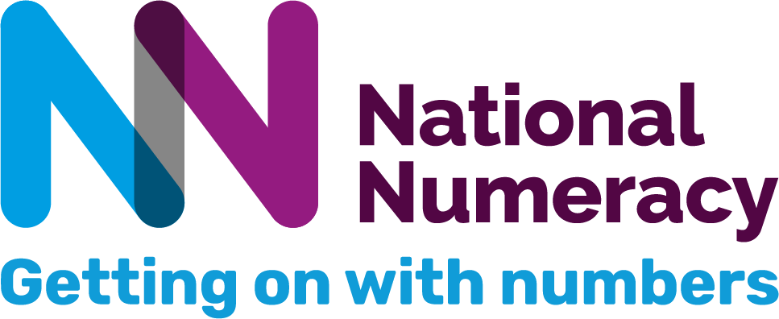
Curriculum Issue
“The school curricula tends to centre on a wide range of increasingly abstract mathematics, often covered at a superficial level. There is rarely time to devote to the kind of practical problem ('relatively simple maths in complex real-world situations') that often arises in healthcare settings.”
“We take GCSE as evidence that they have good numeracy, but once they are in the job the cracks start to appear”
“The job description comes in and they ask what qualifications they’ve got - but do we pay enough attention to whether literacy and numeracy is included in that? Or do we assume?”
In a project with social science students at universities, who had at least GCSE grade C,
only 26% of those assessed had the
Essentials of Numeracy.
The Essentials of Numeracy for Healthcare (2018)

Slide 14
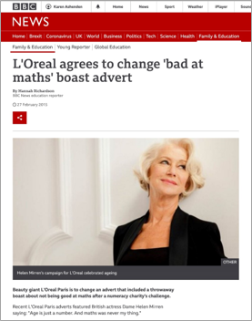
Culture around Numeracy
“Age is just a number. And maths was never my thing.”

Slide 15

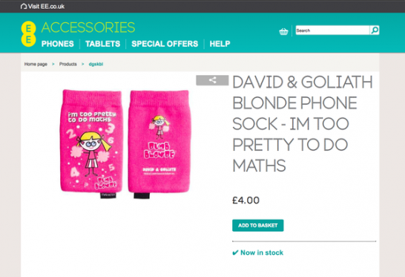
Culture around Numeracy

Slide 16

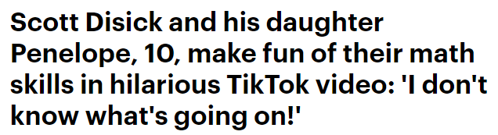
Culture around Numeracy
In the clip, a soundbite was used and lip-synced to by the father-daughter duo, who appeared to say 'I don't know what's going on and I simply don't want to know.'

Slide 17
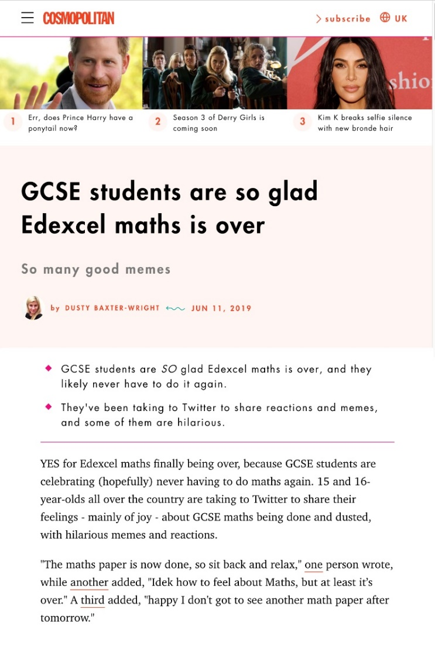
Culture around Numeracy
“GCSE students are SO glad
it is over and they will never have to do maths again.”
“15 and 16 year olds up and down the country are celebrating (hopefully) never having to do maths again”

Slide 18

Impact of poor numeracy on individuals
Reduced employment prospects
Inability to progress in some careers
Poor productivity
Low confidence and self-esteem
Poor financial capability
Impacts on home life

Slide 19

Impact of poor numeracy on workplaces
Recruitment and retention
Staff progression
Efficiency and productivity
Staff wellbeing and confidence at work

Slide 20
Maths Anxiety
Maths anxiety has been defined by Tobias and Weissbrod (1980) as, “the panic, helplessness, paralysis, and mental disorganisation that arises among some people when they are required to solve a mathematical problem.”
Research by the University of Cambridge has found that, “many children and adults experience feelings of anxiety, apprehension, tension or discomfort when confronted by a maths problem.”

Slide 21

What causes maths anxiety?
Negative experiences at school
Feeling under pressure
Fear of failure
Being told you’re not a maths person
Lack of support
Dyscalculia

Slide 22
What does maths anxiety look like?
Feeling panicked or stressed
Feeling flustered or struggling to concentrate
Frustration and “shutting down” or “going blank”
Physical symptoms
Avoiding situations which involve maths

Slide 23
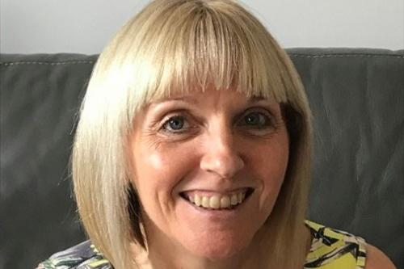
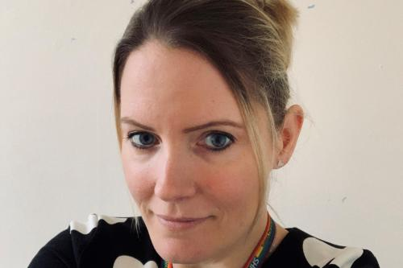
Maths anxiety: real perspectives
“It makes me feel silly. I'm scared of
being judged if I’m wrong. It reminds me
of being told off in school. I’m clamming up just thinking about it”
Cathy, Bradford
“Even the thought of it would dry my mouth
and make my palms sweaty. I remember the first day of school with everyone reciting their times tables and thinking, “I don’t know what’s going on”, feeling totally lost and frozen on the spot.
On a test I got 1/100, which I hate even
talking about“ Stacey, Chichester

Slide 24

Tips to overcome maths anxiety
Talk about your feelings about maths
Challenge your own beliefs
Try not to compare yourself to others
Reduce pressure
Set realistic goals

Slide 25
What is dyscalculia?
Dyscalculia is an unexpected and persistent learning difficulty that makes it hard to understand, learn, or use maths.
Often described as “dyslexia with numbers” – it is much less well-known than dyslexia.
Dyscalculia makes learning arithmetic much more difficult, such as recognising numbers, using sequences, counting backwards, estimating and understanding place value.

Slide 26
How does dyscalculia affect your life?
Dyscalculia can slow down academic progress and career progression and may cause strong anxiety about maths. Day-to-day effects may include trouble with:
Recalling PIN or telephone numbers
Managing time
Planning journeys
Following directions
Telling if one amount is greater than another
Understanding distances

Slide 27
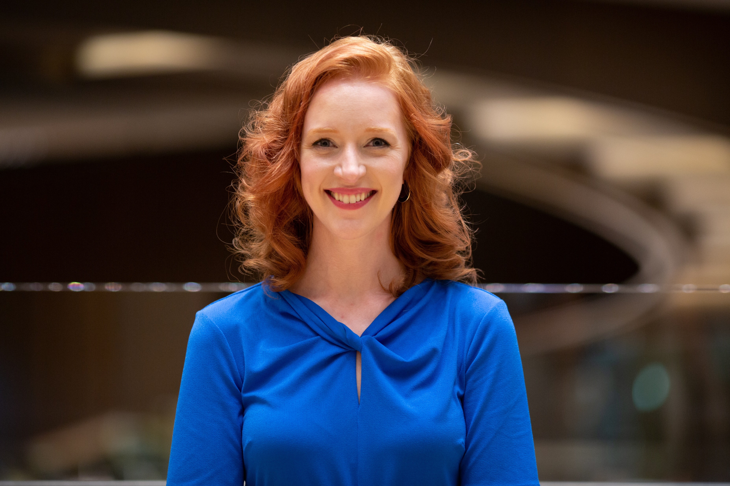
Real life experiences
“I was diagnosed with mild dyscalculia at school and have always struggled with maths, so I know what it’s like to lack number confidence. But when I started talking and writing about personal finance in my 20s, I realised just how important it is to be unafraid of numbers if you want to manage your money well on a day-to-day basis.“
Iona Bain, National Numeracy Ambassador

Slide 28
What support is available for dyscalculia?
Information and support are available from The Dyscalculia Network
You can arrange to be assessed for dyscalculia by contacting the British Dyslexia Association
Whether you have dyscalculia, maths anxiety or lack confidence with numbers, you can improve as an adult. Improvement may be slower and specialist support may be needed.

Slide 29
Value, Belief and Persistence

Slide 30

Value, Belief and Persistence

Slide 31
Value
Think of a task you regularly do at work. Map out the numeracy involved in your chosen task.
Managing staff rotas
Knowledge of safe staffing levels
Understanding contracted hours
Factoring in breaks
Taking annual leave into account

Slide 32
Growth Mindset
Everyone can improve their numeracy; ability is not fixed.
Growth Mindset
Ability is not fixed.
You can learn and improve at anything if you put enough time and effort into it.
If you put your mind to it you will be able to improve: ability isn’t something you’re born with.
Fixed Mindset
Talent is innate.
Some people just can’t
do certain things: they need to accept that and find something else they can do.
There is no point in trying to improve if you aren’t born with ability.

Slide 33
Impact of a fixed mindset
If a learner has a fixed mindset and experiences a setback….
Psychological interpretation
Behavioural response
Learning outcome
I can’t do this and I’ll never get it.
Decreased effort and greater use of negative strategies
Decreased engagement and performance

Slide 34
Impact of a growth mindset
If a learner has a growth mindset and experiences the same setback….
Psychological interpretation
Behavioural response
Learning outcome
I need to find a different way to do this and try again.
Increased effort and use of positive strategies
Increased engagement and performance

Slide 35
Persistence
Think of something, other than maths, that you have struggled with.
How did this make you feel?
What steps did you take to overcome the difficulties?
Why didn’t you give up?

Slide 36
Establishing a habit
Keep in mind why you want to improve your numeracy and how it will benefit you
Keep it small – a little bit every day
Anchor your new habit to an established routine
Be consistent, not perfect

