Slide 1
Becoming a Numeracy Champion
Session 2

Slide 2
Housekeeping
Keep microphones on mute unless speaking
Change your name to be first name + surname using the three dots next to your name under Participants
The session is being recorded
Where possible, please have your camera on
In breakout rooms, nominate one person to feed back to the main room
Raise hand to ask or answer questions

Slide 3
Programme Objective
To give you the knowledge and skills to support colleagues to improve their skills and confidence with numbers.

Slide 4
Session 2 Objectives
Understand the ways that National Numeracy resources and support can be used to engage learners
Learn how to access data from the National Numeracy Challenge and how it can help meet organisational targets
Explain practical next steps to support colleagues with maths
Create an Action Plan to implement following the programme

Slide 5
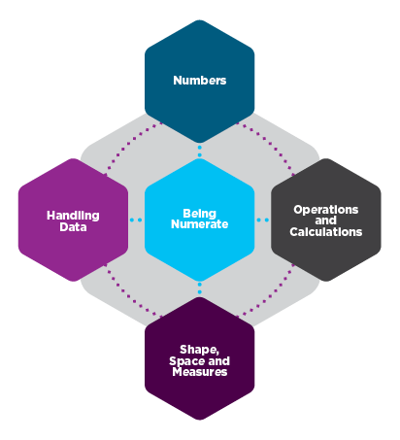
The Essentials of Numeracy
Fractions
Decimals
Rounding
…the numeracy you will need to be confident in everyday work and life not the maths you associate with learning at school.
Addition & Subtraction
Division & Multiplication
Percentage Calculations
Ratios
Understanding data
Using graphs and charts
Probability
Measurements (e.g. height, weight etc)
Direction
Units and conversions

Slide 6
What does the score mean?
NN Challenge Quick Check | NN Challenge Check-Up | Functional Skills Level | School
16-20 Essentials of Numeracy | 80 to 100 Essentials of Numeracy | Level 1 / Level 2 | New GCSE 9 – 4 Old GCSE A* - C
12-15 | 60 to 79 | Level 1 | New GCSE 3 – 1 Old GCSE D – G
8-11 | 40 to 59 | Entry Level 3 | Expected age 9 to 11
4-7 | 20 to 39 | Entry Level 2 | Expected age 7 to 9
0-3 | 0 to 19 | Entry Level 1 | Expected age 5 to 7

Slide 7
National Numeracy Challenge

Slide 8
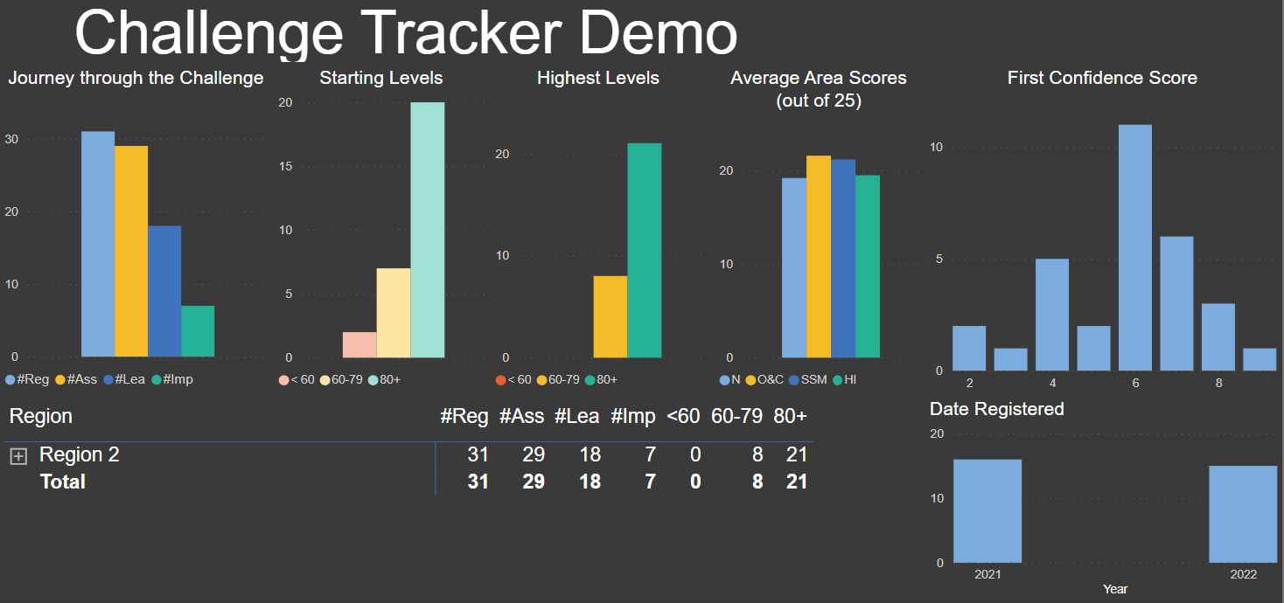
Challenge Tracker

Slide 9
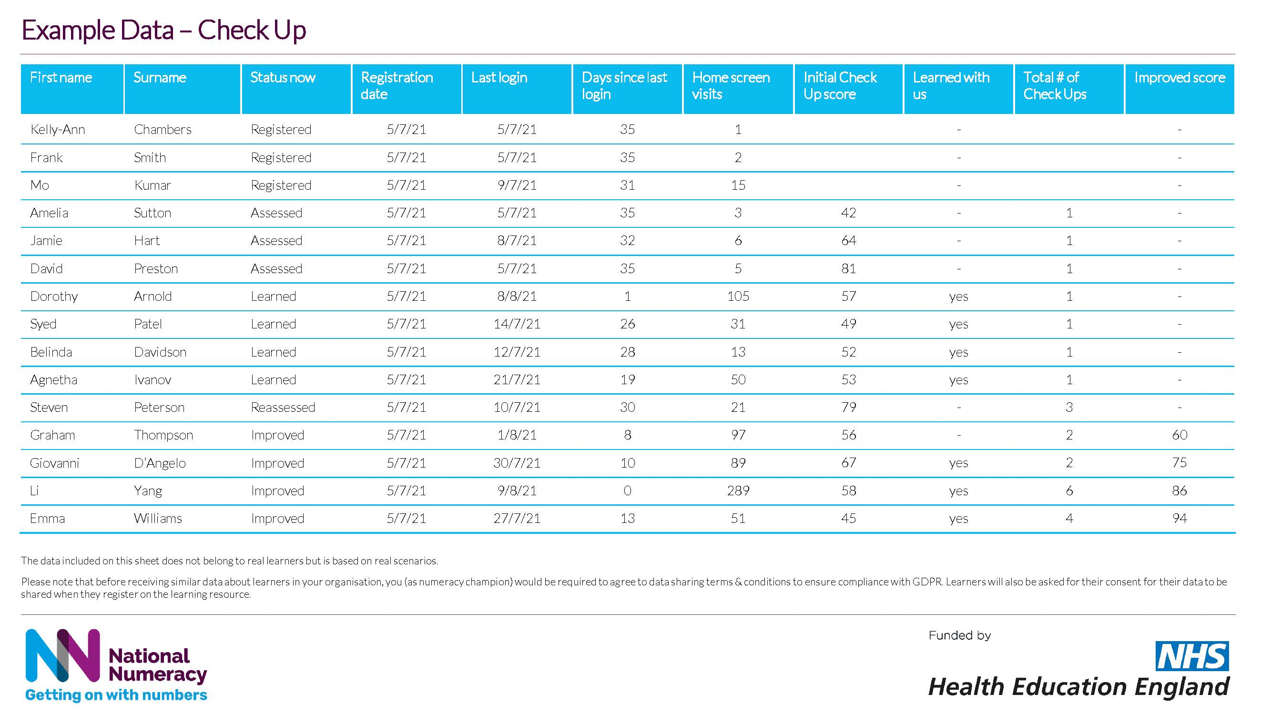
Understanding the data

Slide 10
Direct to Learner Workshop
1 hour workshop delivered in-person or online
Aimed at individuals with low skills or low confidence with numbers
How do you feel about maths? Maths anxiety
Value, Belief and Persistence
Mythbuster
Introduction to the National Numeracy Challenge
Full toolkit for Numeracy Champions to deliver independently.

Slide 11
Direct to Learner Workshop
Drop-in sessions for members of the community/organisation
Functional Skills courses
Staff Inductions
Apprenticeships
Lunch and Learn
Campaigns

Slide 12
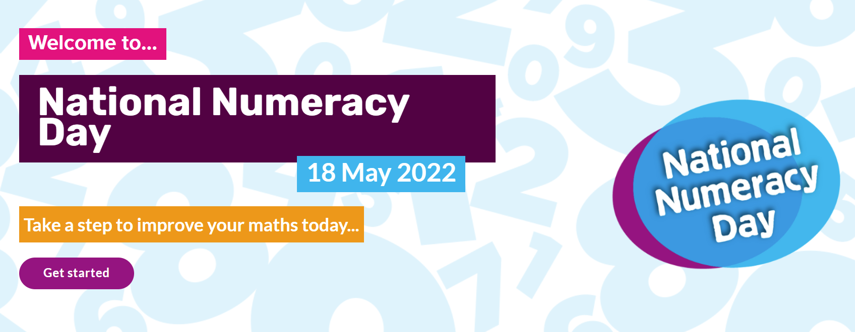
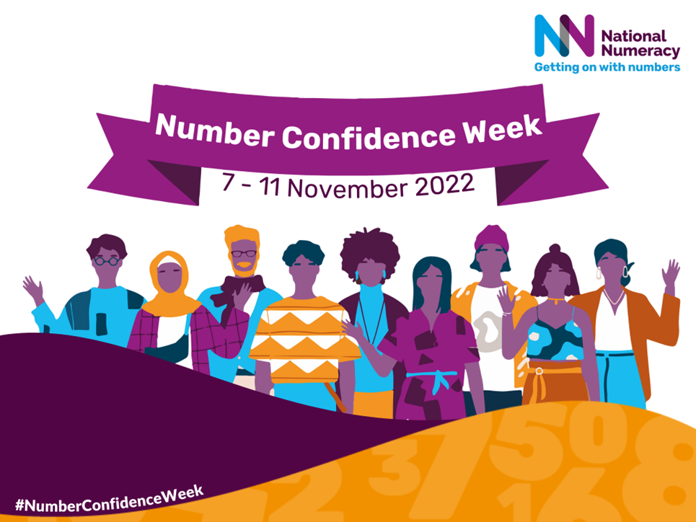
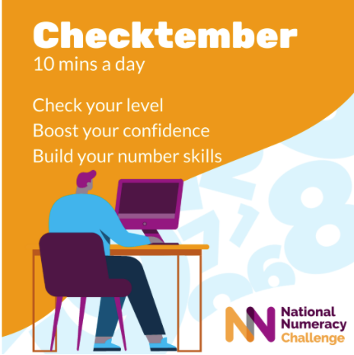
National Numeracy Campaigns

Slide 13
National Numeracy Day 2022

Slide 14
Parent Workshop
1 hour attitudinal workshop delivered by National Numeracy
Top tips for supporting children to develop positive attitudes towards maths
Point out maths in the real world
Talk positively about maths
Praise effort, rather than talent
Boost your own confidence

Slide 15
What else can a trained Champion do?
Gather and share case studies
Build advocacy in your organisation
Attend forums for trained Numeracy Champions
Promote numeracy on social media
Share tips on overcoming maths anxiety
Share information on dyscalculia and Functional Skills qualifications
Support learners with low digital skills

Slide 16
Potential barriers in learners
Maths anxiety
Access to/confidence with technology
Idea that maths is irrelevant to their job
Belief that it is unnecessary to improve their maths
Feeling of being too old to improve
Time

