Slide 1
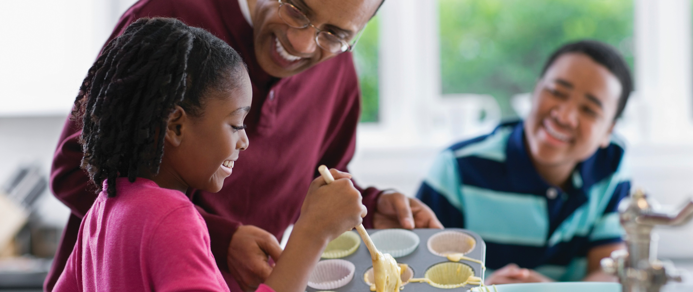
Help Your Child Love Maths!

Slide 2

How do you feel about maths?

Slide 3
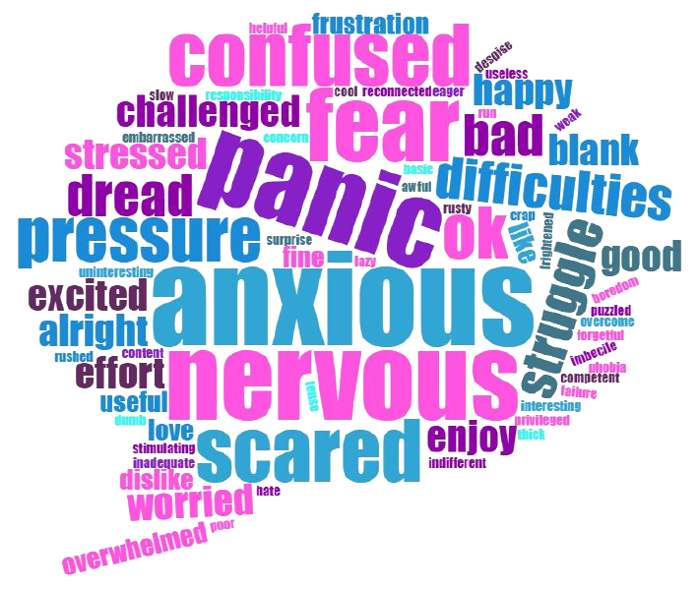
How do you feel about maths?

Slide 4
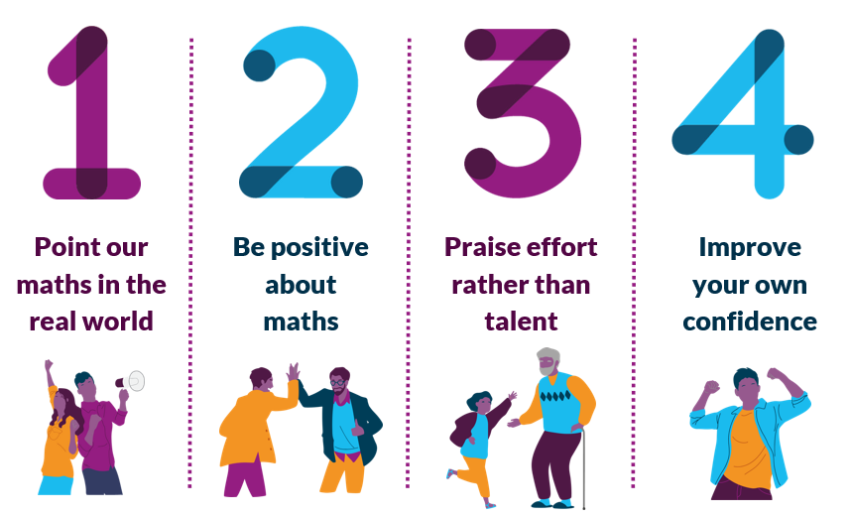
National Numeracy’s top tips for families

Slide 5

National Numeracy’s top tips for families

Slide 6
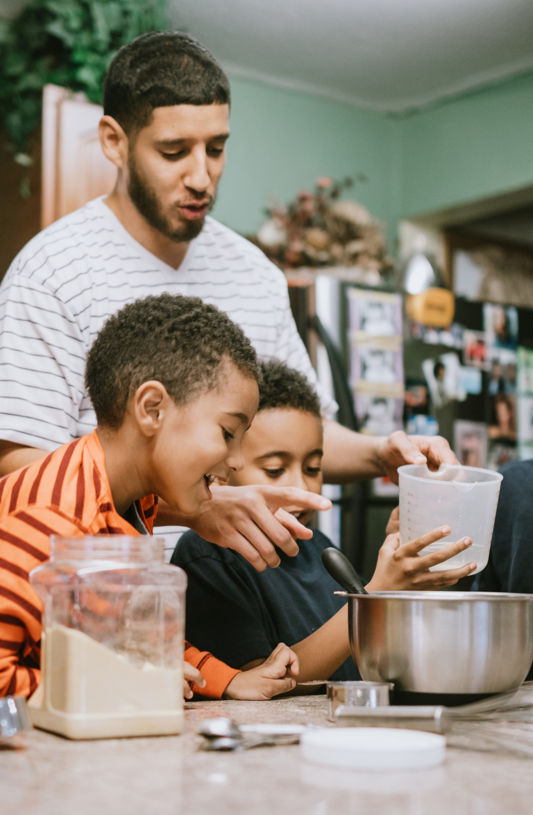
Point out the maths in everyday life

Slide 7
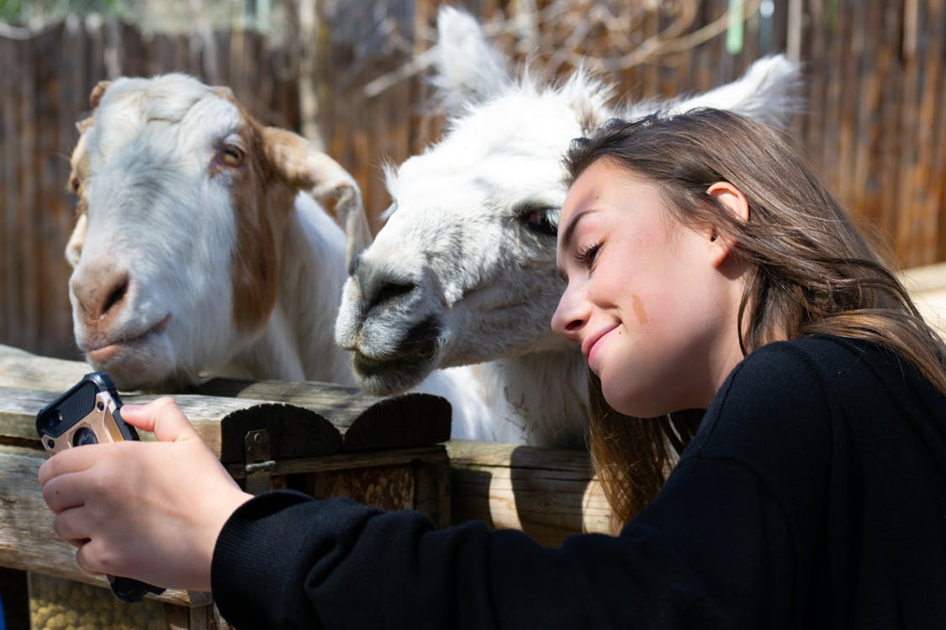


Maths in everyday life
Consider a scenario from daily life.
How are numbers involved?
What opportunities are there to point out numbers to your children?
“Students’ motivation to learn maths is higher among students whose parents discuss how mathematics can be applied to everyday life,” (The Programme for International Student Assessment 2013).

Slide 8
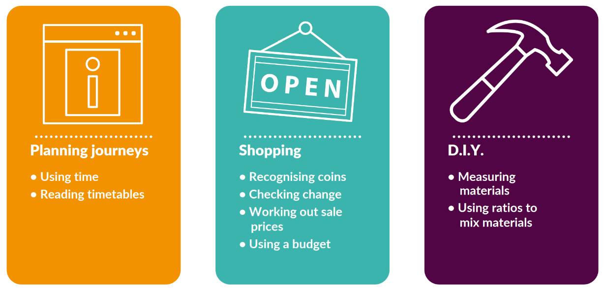
Maths in everyday life

Slide 9
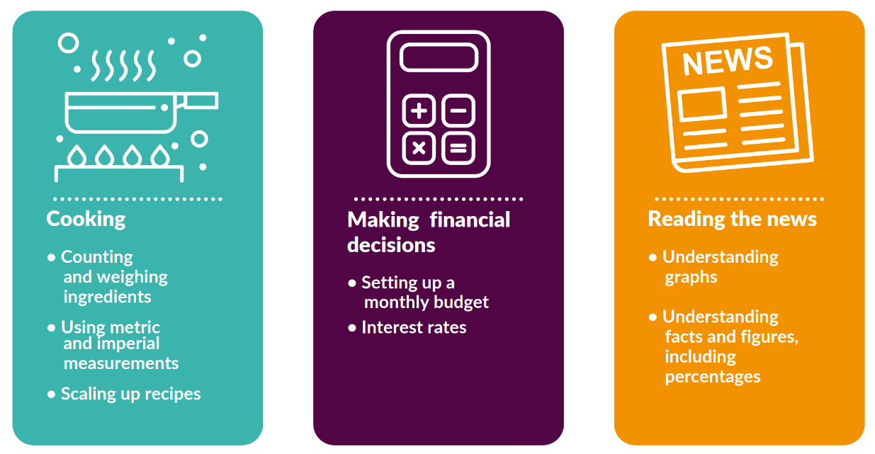
Maths in everyday life

Slide 10

Be positive about maths

Slide 11
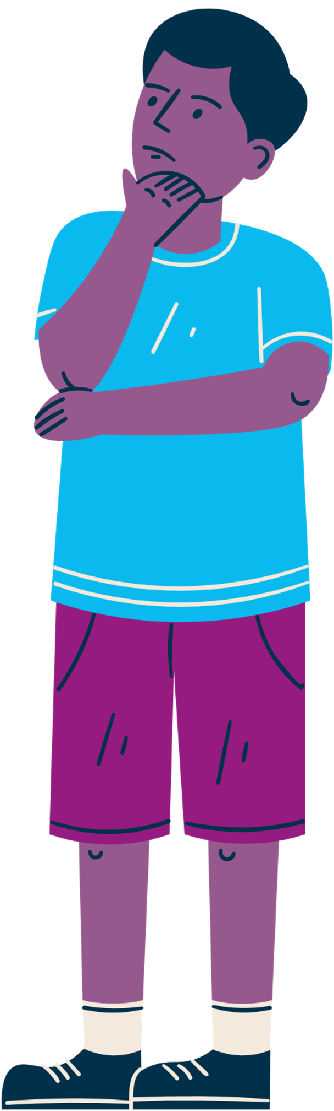
Be positive about maths
Here are some things people sometimes say to children about maths.
Have you heard these things being said?
What could be said instead to encourage positive attitudes in children?

Slide 12


Be positive about maths
“I was never any good at maths at school and it did me no harm.”

Slide 13


Be positive about maths
“You won’t need to worry about maths once you’ve finished school.”

Slide 14


Be positive about maths
“It’s ok. You can’t be good at everything. You’re better at literacy. Your brother is more of a maths-y person.”

Slide 15


Be positive about maths
“Well done for getting that right. You’re so clever.”

Slide 16

Praise effort, rather than talent

Slide 17
Praise effort, rather than talent
Examples of praising talent:
Well done. You’re so clever.
You’re naturally really good at this.
It’s amazing that maths is so easy for you.
Examples of praising effort:
Well done for working so hard at that.
You’ve learned so much, well done.
It’s great that you kept going with that even when it was tricky.

Slide 18
Growth Mindset
Fixed Mindset
Talent is innate
Some people just can’t do certain things
There is no point in trying to improve if you aren’t born with the ability
Growth Mindset
Ability is not fixed
You can learn and improve at anything is you put enough time and effort into it
If you put your mind to it, you will be able to improve: ability isn’t something you’re born with

Slide 19
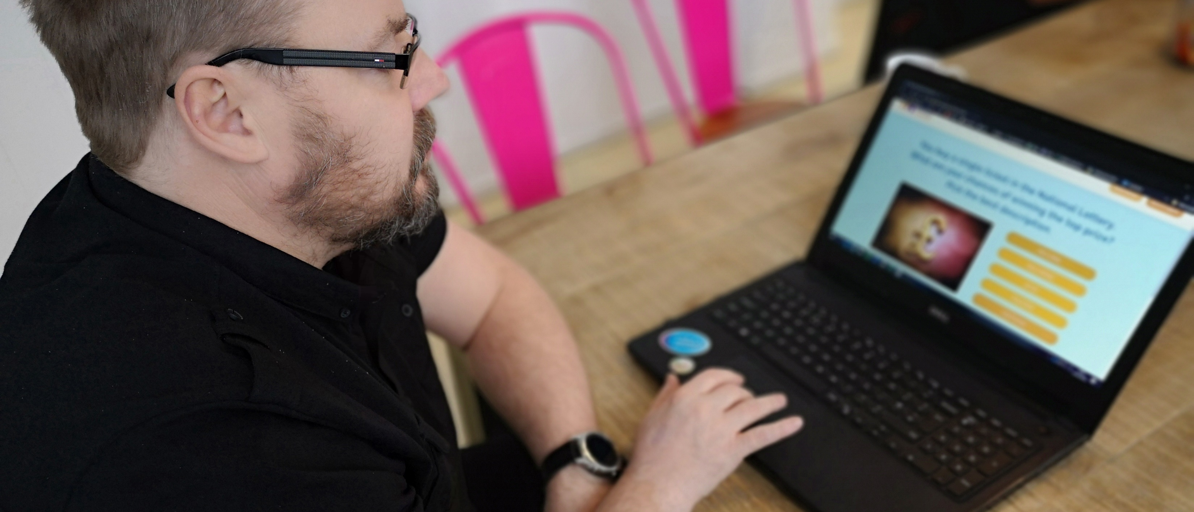
Boost your own confidence

Slide 20

Boost your own confidence

Slide 21
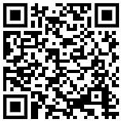

National Numeracy Challenge
www.nationalnumeracy.org.uk/challenge/sfthh24aq

